Slide 1
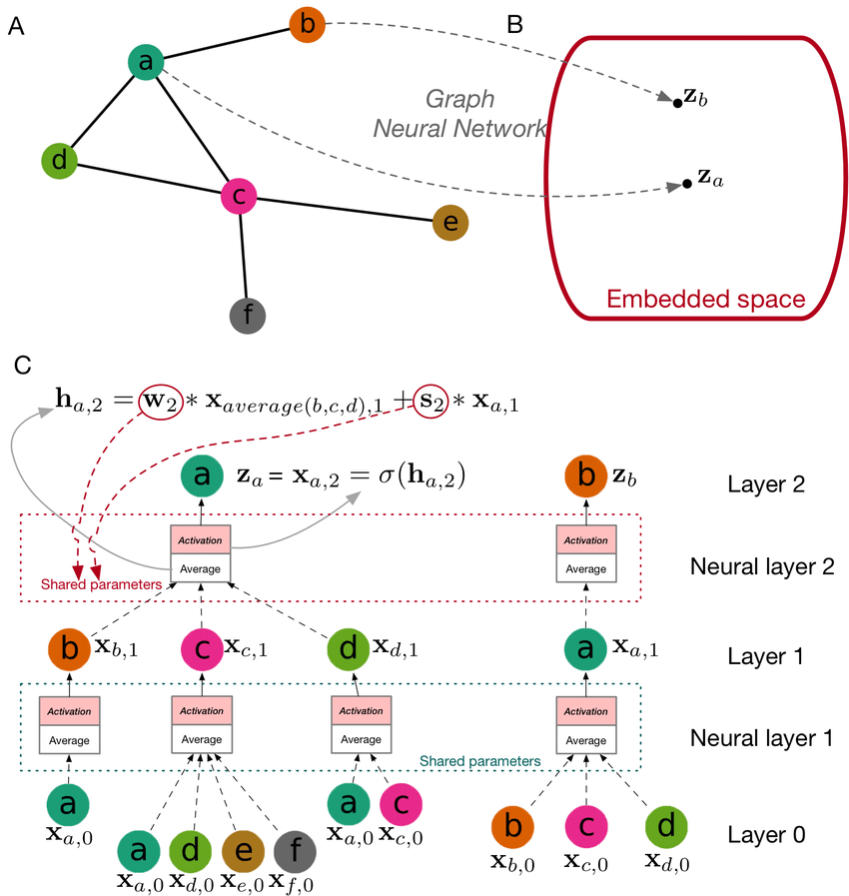

Graph Neural Networks II
张江
北京师范大学系统科学学院教授
集智俱乐部、集智学园创始人
集智研究中心理事长
更多“人工智能 & 复杂系统”的知识，请关注官网：campus.swarma.org
Notes:
封面

Slide 2

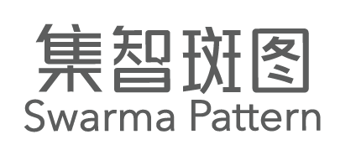
Outline
Variational Graph Autoencoder
VGAE
Link prediction as a proxy
Network Completion
Static completion
Dynamic completion
As a generative model
Graph Generation
Graph RNN
Normalizing Flows
Diffusion models
更多“人工智能 & 复杂系统”的知识，请关注官网：campus.swarma.org

Slide 3
Network Embedding v.s. Graph Neural Networks
Graph Convolution Networks
Matrix Factorization
Graph Attention Networks
Graph
Auto-encoder
Random Walk
Graph Generative Networks
Network Embedding
Graph Spatial-temporal Networks
Graph Neural Networks
更多“人工智能 & 复杂系统”的知识，请关注官网：campus.swarma.org

Slide 4
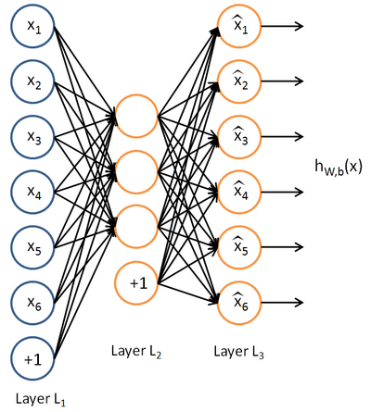
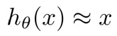
Autoencoder
Unsupervised learning
Feed-back
Reconstruct input:
BP Learning
Constraints
更多“人工智能 & 复杂系统”的知识，请关注官网：campus.swarma.org

Slide 5
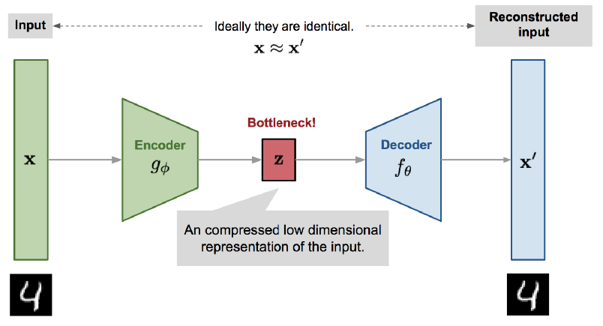
Variational Autoencoder
更多“人工智能 & 复杂系统”的知识，请关注官网：campus.swarma.org

Slide 6
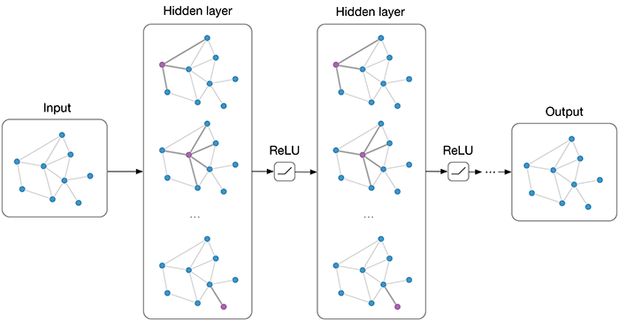
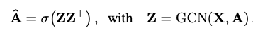
Graph Autoencoder
https://arxiv.org/pdf/1611.07308.pdf

Slide 7
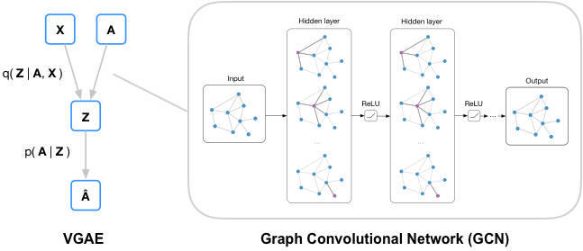
Variational Graph Autoencoder
https://github.com/tkipf/gae

Slide 8
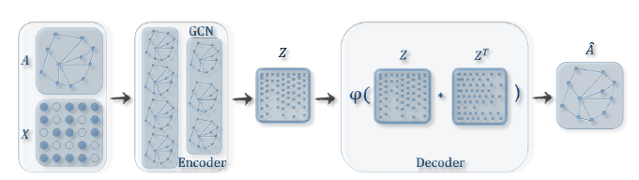
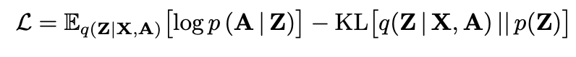
Variational Graph Autoencoder
Encoder：
Decoder:
(generative model)：
Learning:
https://zhuanlan.zhihu.com/p/78340397
https://github.com/tkipf/gae

Slide 9
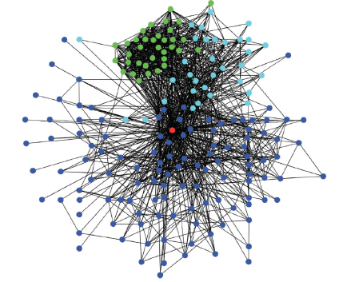
Link Prediction
更多“人工智能 & 复杂系统”的知识，请关注官网：campus.swarma.org

Slide 10
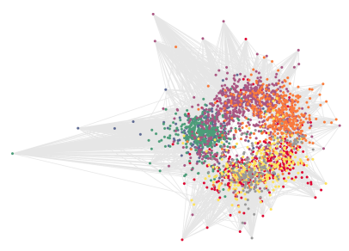
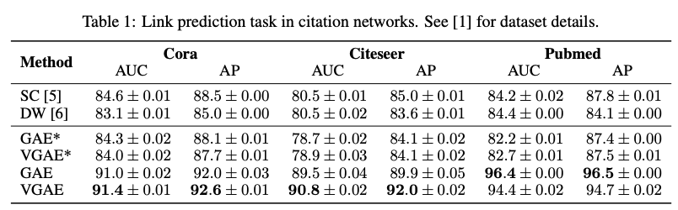
Results – Variational Graph Autoencoder
https://arxiv.org/pdf/1611.07308.pdf

Slide 11
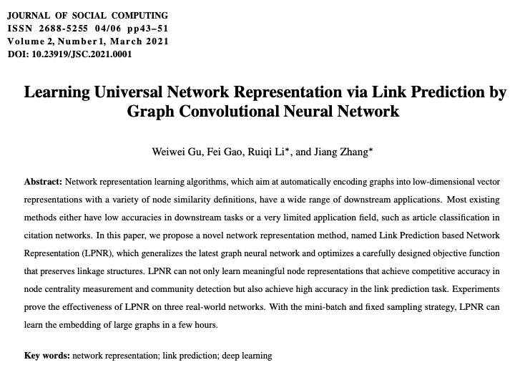
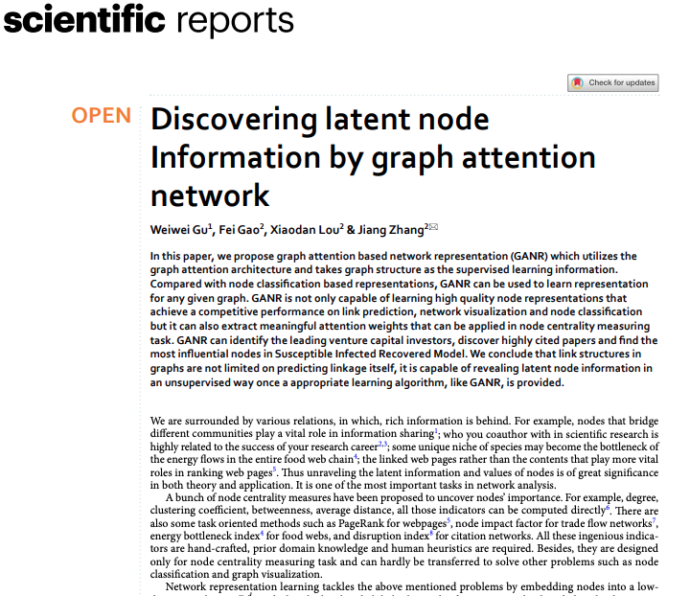
Representation via Link Prediction
谷伟伟
https://ieeexplore.ieee.org/document/9355034
https://www.nature.com/articles/s41598-021-85826-x

Slide 12
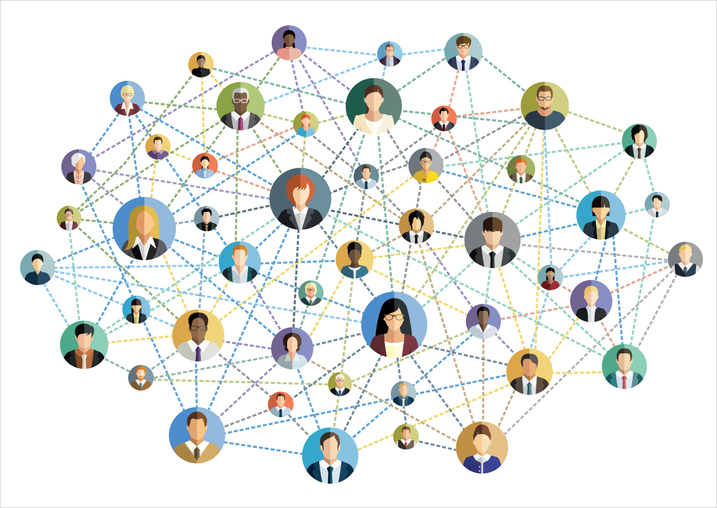
Main Idea
Graph Attention Network for Link Prediction
Centrality
Community
Node Classification
https://arxiv.org/abs/1710.10903

Slide 13
Pipe Line
Graph Attention Network
Network
Attention
Node Vector
Node Vector
Backward
Gu, W., Gao, F., Lou, X. et al. Discovering latent node Information by graph attention network. Scientific Reports 11, 6967 (2021).

Slide 14
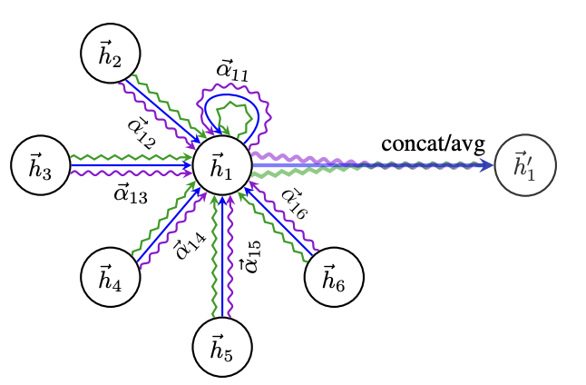
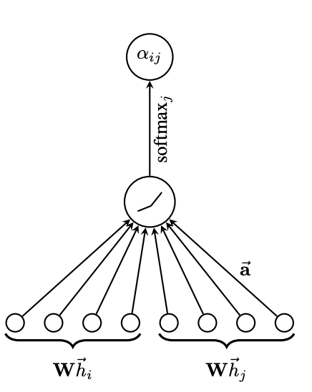
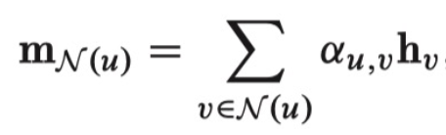
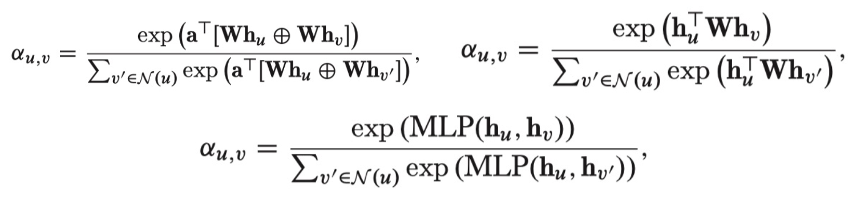
Graph Attention Network
https://arxiv.org/abs/1710.10903

Slide 15
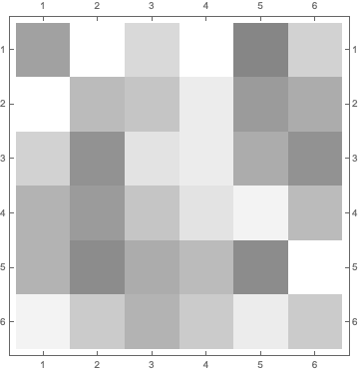

Pipe Line
Connection Probability Matrix
Network
Graph Attention Network
Node Vectors
N₁
Node Vectors
N₂
N₃
N₄
$$σ$$
N₅
N₆
N₇
N₈
N₉
N₁₀
Node Vectors
Backward
Gu, W., Gao, F., Lou, X. et al. Discovering latent node Information by graph attention network. Scientific Reports 11, 6967 (2021).

Slide 16
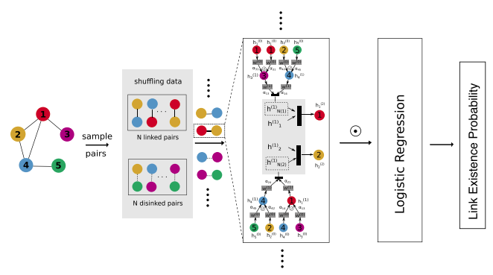
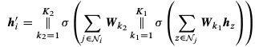
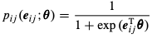
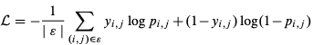
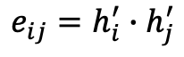
Graph Attention Network for Large Networks
$$e_{ij}=h_{i}^{′}∙h_{j}^{′}$$
Gu, W., Gao, F., Lou, X. et al. Discovering latent node Information by graph attention network. Scientific Reports 11, 6967 (2021).

Slide 17
Results – Link Prediction
Gu, W., Gao, F., Lou, X. et al. Discovering latent node Information by graph attention network. Scientific Reports 11, 6967 (2021).

Slide 18
Pipe Line
j
Node Vectors
Network
Graph Attention Network
i
Attentional weights matrix
N₁
N₂
N₃
N₄
Logistic
N₅
N₆
N₇
N₈
N₉
N₁
N₁₀
N₂
N₃
N₄
N₅
N₆
N₇
Node Vectors
N₈
N₉
N₁₀
Gu, W., Gao, F., Lou, X. et al. Discovering latent node Information by graph attention network. Scientific Reports 11, 6967 (2021).

Slide 19
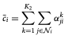
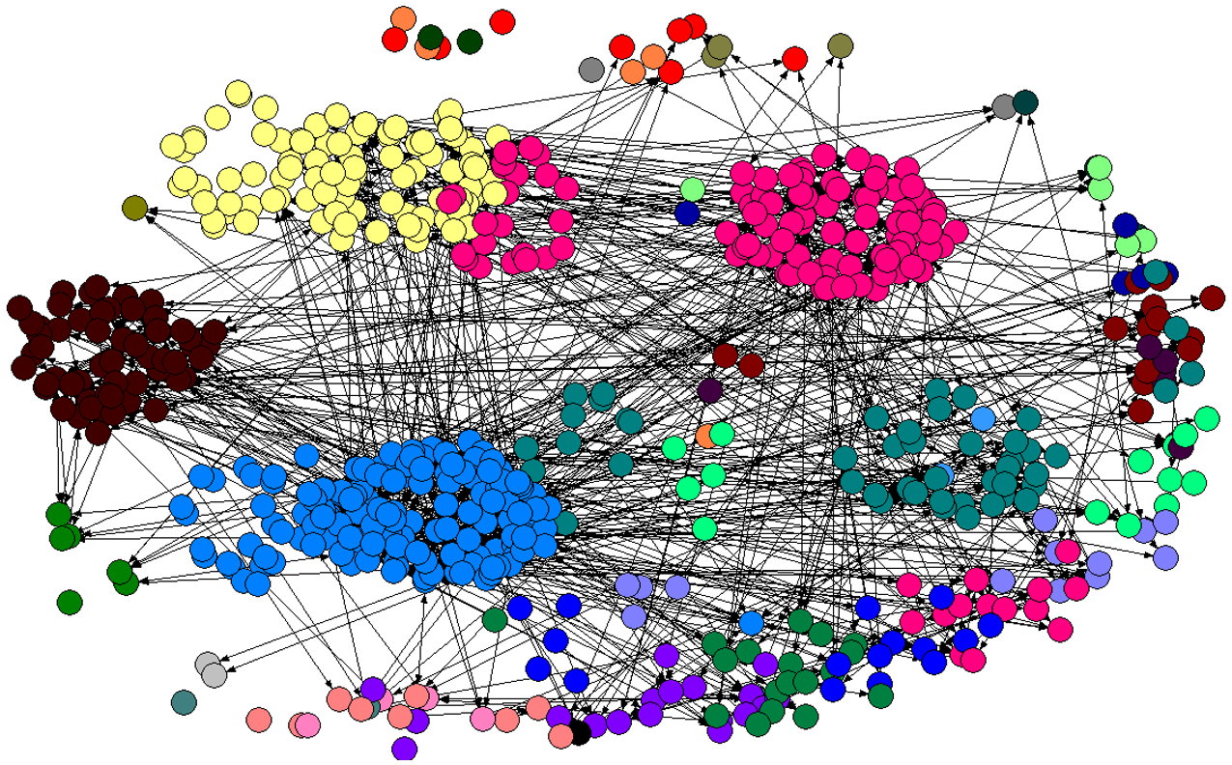
Results – Visualization
VC network: VC co-invest
Visualization for attentional matrix by MDS algorithm
Gu, W., Gao, F., Lou, X. et al. Discovering latent node Information by graph attention network. Scientific Reports 11, 6967 (2021).

Slide 20
Results – Centrality
Label
Label
Gu, W., Gao, F., Lou, X. et al. Discovering latent node Information by graph attention network. Scientific Reports 11, 6967 (2021).

Slide 21
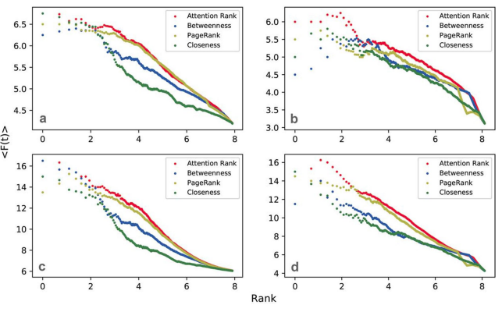
Results – Centrality
Figure 1. The comparison between the spreading power of different ranking algorithms over F(t). In panels (a) and (b), we plot the average number of F(t) for t = 3 of the top-L users as ranked by the five centrality measures of Cora (a) and Citeseer (b) graphs, while in panels (b) and (d), we plot the average number of F(t) for t = 9 of Cora (c) and Citeseer (d) graphs.
Gu, W., Gao, F., Lou, X. et al. Discovering latent node Information by graph attention network. Scientific Reports 11, 6967 (2021).

Slide 22
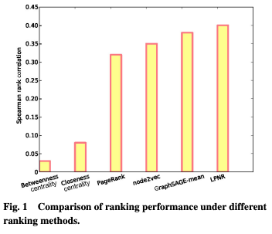
Results – Centrality
Gu, W., Gao, F., Lou, X. et al. Discovering latent node Information by graph attention network. Scientific Reports 11, 6967 (2021).

Slide 23
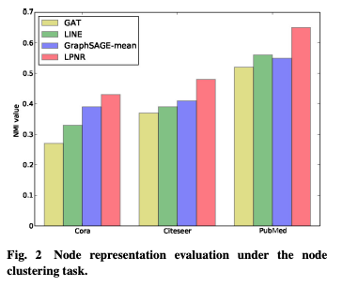
Node Clustering
Cora dataset
GraphSAGE
Ours
ours
Visualization for Node Representation Vectors
Gu, W., Gao, F., Lou, X. et al. Discovering latent node Information by graph attention network. Scientific Reports 11, 6967 (2021).

Slide 24
Node Clustering
ours
Deep Linker = ours
Gu, W., Gao, F., Lou, X. et al. Discovering latent node Information by graph attention network. Scientific Reports 11, 6967 (2021).

Slide 25
Outline
Variational Graph Autoencoder
VGAE
Link prediction as intermediate task
Network Completion
Static completion
Dynamic completion
As a generative model
Graph Generation
Graph RNN
Normalizing Flows
Diffusion models
更多“人工智能 & 复杂系统”的知识，请关注官网：campus.swarma.org

Slide 26
Network Completion
Missing data
Noisy data
Incomplete information
Social network
Gene network
Brain network
Citation network
更多“人工智能 & 复杂系统”的知识，请关注官网：campus.swarma.org

Slide 27
Two Kinds of Tasks
Random Missing
Block Missing
更多“人工智能 & 复杂系统”的知识，请关注官网：campus.swarma.org

Slide 28
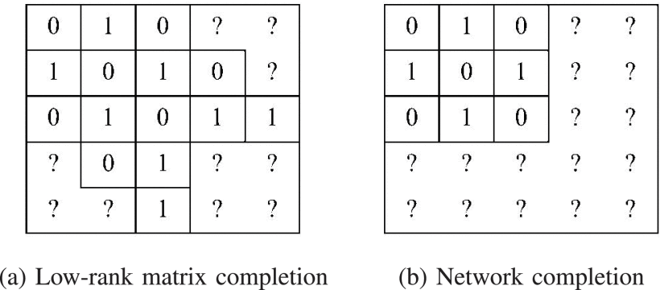
Matrix Completion v.s. Network Completion
https://ieeexplore.ieee.org/document/9334012

Slide 29
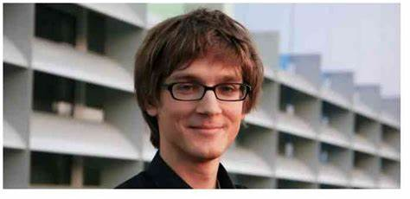
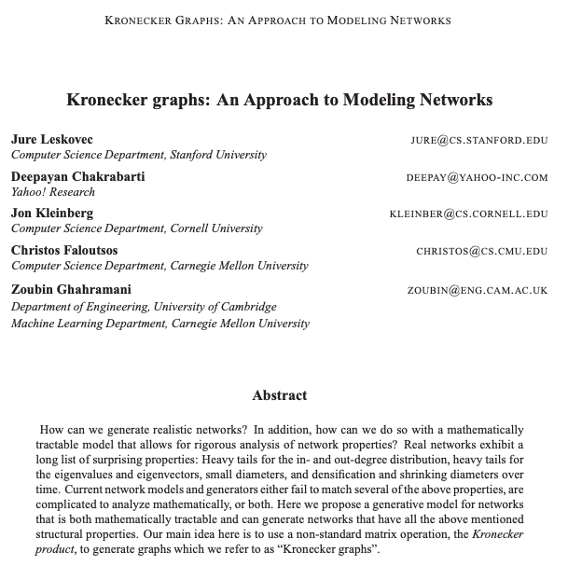
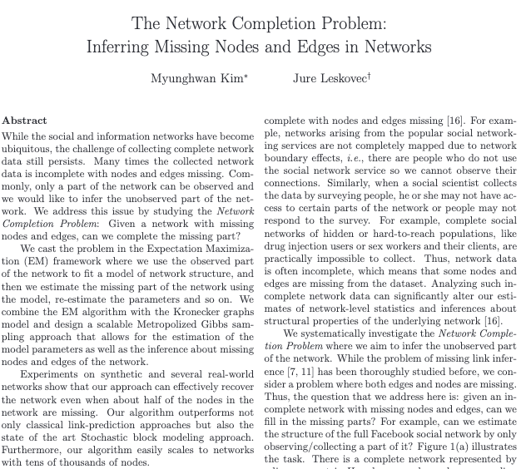
Kronecker Graphs
https://arxiv.org/pdf/0812.4905.pdf

Slide 30
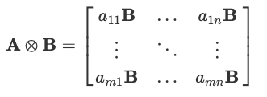
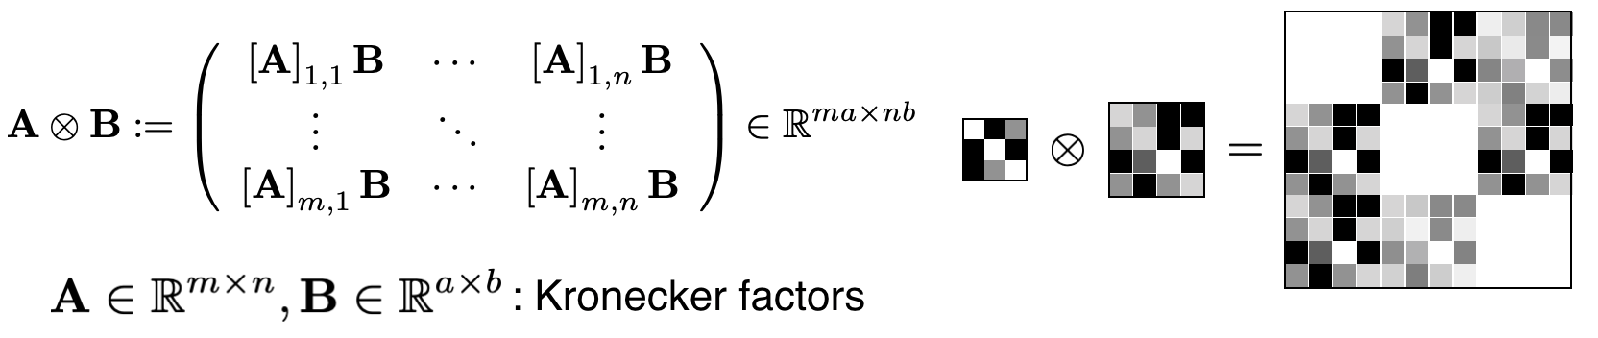
Kronecker Graphs
P. M. Weichsel, "The kronecker product of graphs", J. Am. Math. Soc, vol. 13, no. 1, pp. 47-52, 1962.

Slide 31
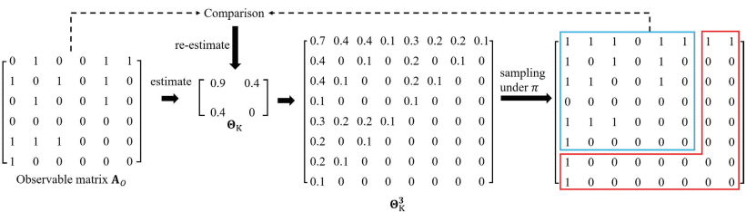
Kronecker Graphs
M. Kim and J. Leskovec, "The network completion problem: Inferring missing nodes and edges in networks", Proc. 2011 SIAM Int. Conf. Data Mining (SDM '11), pp. 47-58, Apr. 2011.

Slide 32
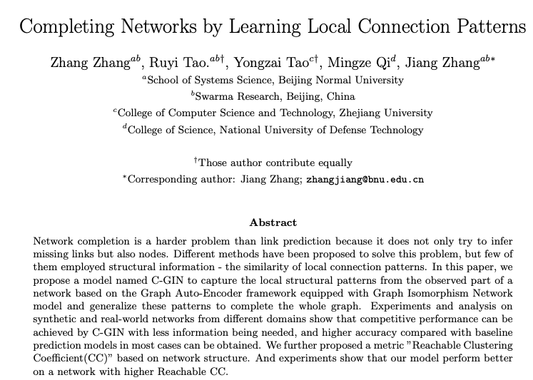
C-GIN Network Completion
张章
陶如意
https://arxiv.org/pdf/2204.11852.pdf

Slide 33
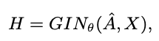
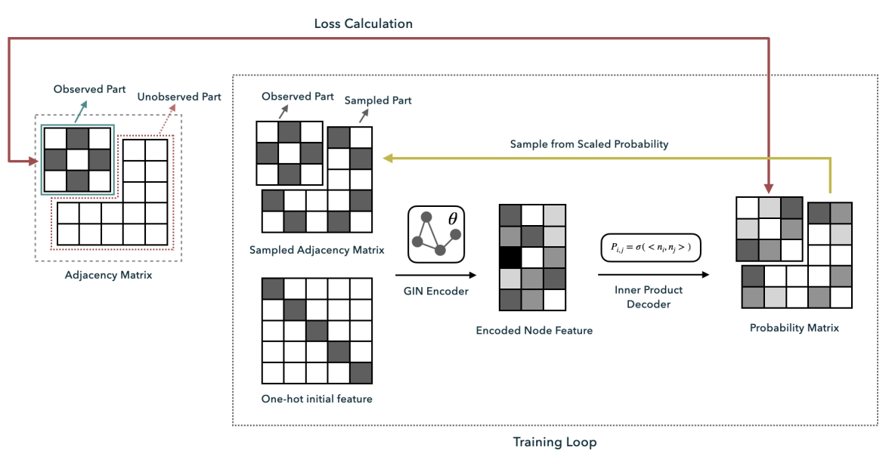
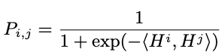
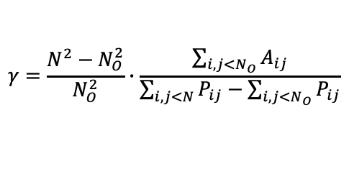
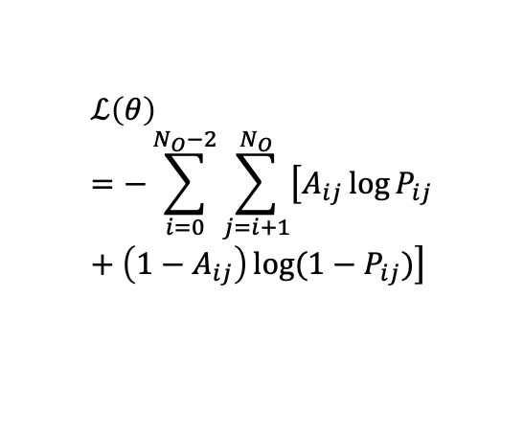
Encoder:
C-GIN Network Completion
Decoder:
Loss function:
$$ℒ\left(θ\right)=−\sum_{i=0}^{N_{O}−2}{\sum_{j=i+1}^{N_{O}}{\left[A_{ij}\log{P_{ij}}+\left(1−A_{ij}\right)\log{(1−P_{ij})}\right]}}$$
Scale factor:
$$γ=\frac{N^{2}−N_{O}^{2}}{N_{O}^{2}}∙\frac{\sum_{i,j<N_{O}}{A_{ij}}}{\sum_{i,j<N}{P_{ij}}−\sum_{i,j<N_{O}}{P_{ij}}}$$
https://arxiv.org/pdf/2204.11852.pdf

Slide 34
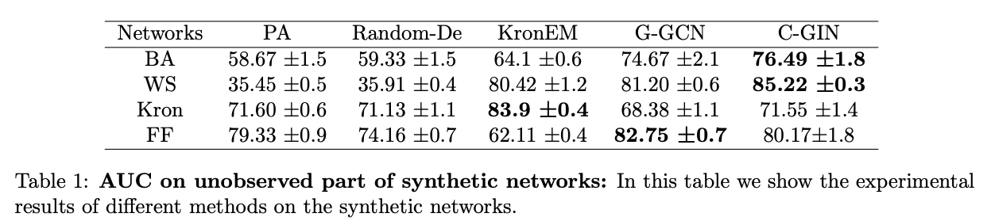
Results
https://arxiv.org/pdf/2204.11852.pdf

Slide 35
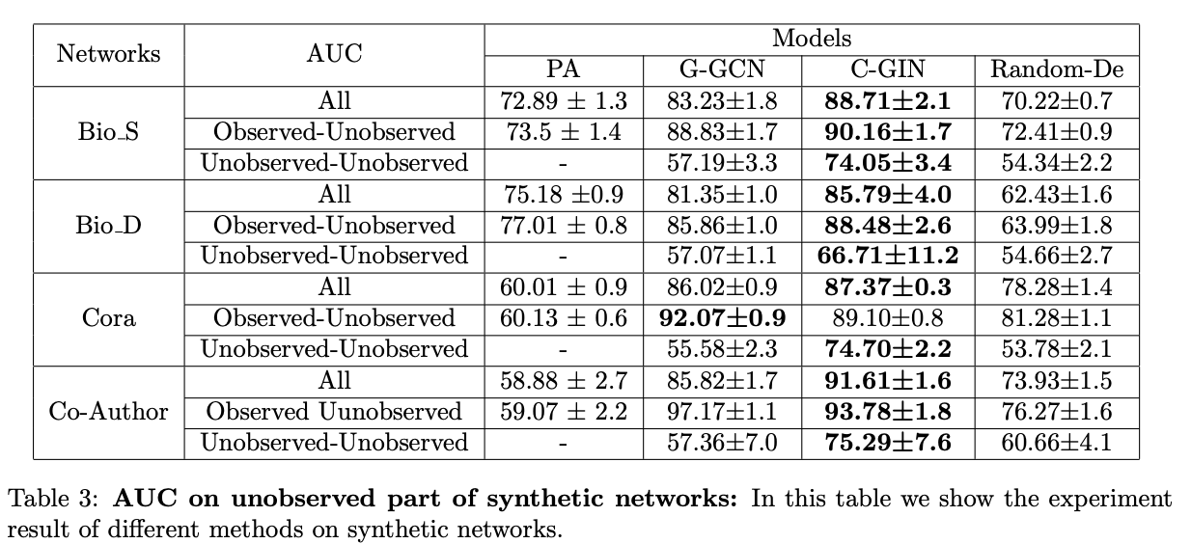
Results
https://arxiv.org/pdf/2204.11852.pdf

Slide 36
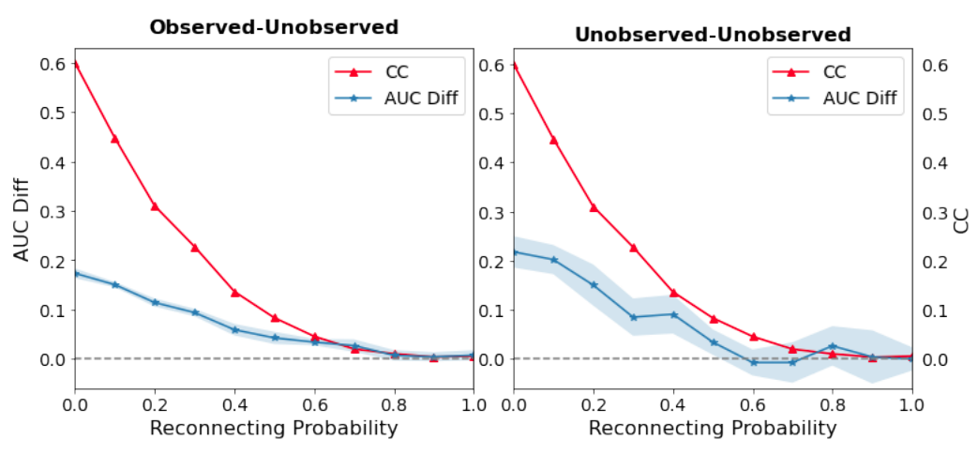
Results
https://arxiv.org/pdf/2204.11852.pdf

Slide 37
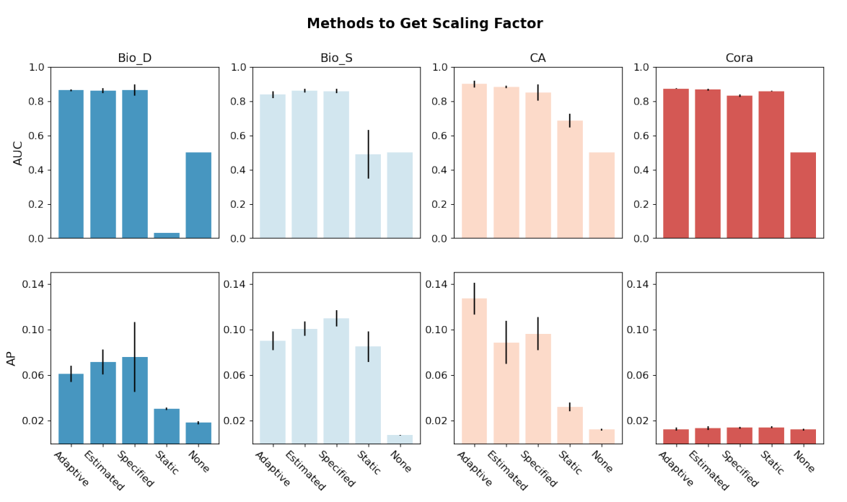
Results
None: We set scaling factor as 1, which means there is no scaling operation.
Specified: We set scaling factor as a specific value(0.001 here).
Static: In this way, we use the decoded probability matrix at the first time in the training process, and calculate the scaling factor by Eq.6
Estimated: In this way, we replace the decoded probability matrix with a uniform random matrix, and then use Eq.6 to calculate the scaling factor.
https://arxiv.org/pdf/2204.11852.pdf

Slide 38
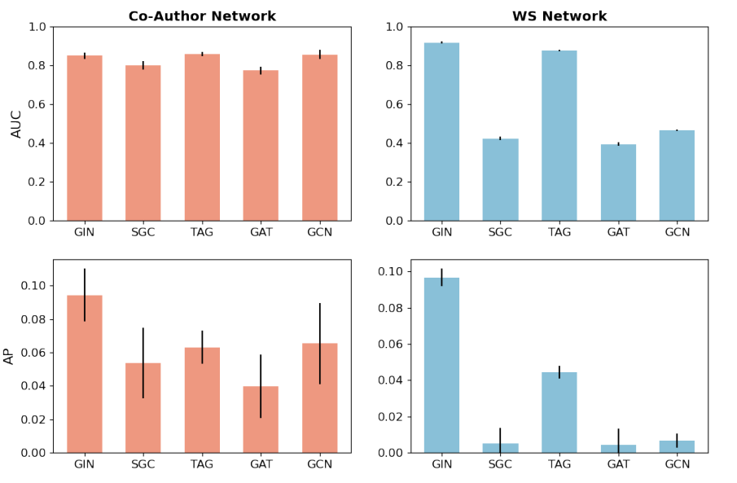
Results
Graph Convolutional Network(GCN)
Graph Attention Network(GAT)
Topology Adaptive Graph Convolutional Network(TAG)
Simplifying Graph Convolutional Networks(SGC)
https://arxiv.org/pdf/2204.11852.pdf

Slide 39
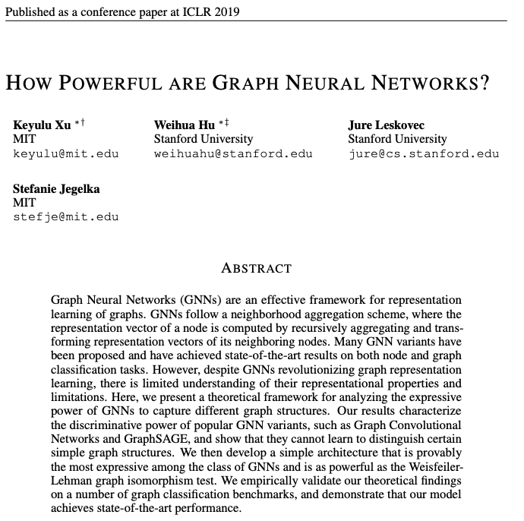


Graph Isomorphism Network
https://arxiv.org/abs/1810.00826

Slide 40

WL(Weisfeler-Lehmann)-test
https://arxiv.org/abs/1810.00826

Slide 41

WL-test
https://arxiv.org/abs/1810.00826

Slide 42



Graph Isomorphism Network
https://arxiv.org/abs/1810.00826

Slide 43

G-GCN
https://arxiv.org/pdf/1903.02640.pdf

Slide 44






G-GCN
Encoding:
Loss:
Prior:
Decoding:
https://arxiv.org/pdf/1903.02640.pdf

Slide 45

Deep NC Method
C. Tran, W.-Y. Shin, A. Spitz and M. Gertz, "DeepNC: Deep generative network completion", IEEE Trans. Pattern Analysis Machine Intell.

Slide 46


Deep NC Method
C. Tran, W.-Y. Shin, A. Spitz and M. Gertz, "DeepNC: Deep generative network completion", IEEE Trans. Pattern Analysis Machine Intell.

Slide 47
Outline
Variational Graph Autoencoder
VGAE
Link prediction as intermediate task
Network Completion
Static completion
Dynamic completion
As a generative model
Graph Generation
Graph RNN
Normalizing Flows
Diffusion models
更多“人工智能 & 复杂系统”的知识，请关注官网：campus.swarma.org

Slide 48





Generative Models of Graphs
WS Model
ER model
BA Model
$$Π\left(k\right)=\frac{k_{i}}{\sum_{i}{k_{i}}}$$
更多“人工智能 & 复杂系统”的知识，请关注官网：campus.swarma.org

Slide 49








Deep Generative Models of Graphs
更多“人工智能 & 复杂系统”的知识，请关注官网：campus.swarma.org

Slide 50

Deep Generative Models of Graphs
https://ieeexplore.ieee.org/document/9920219

Slide 51

Deep Generative Models of Graphs
https://ieeexplore.ieee.org/document/9920219

Slide 52
Deep Generative Models of Graphs
https://ieeexplore.ieee.org/document/9920219

Slide 53

Graph RNN
Jure Leskovec
https://arxiv.org/pdf/1802.08773.pdf

Slide 54







Graph RNN
https://arxiv.org/pdf/1802.08773.pdf

Slide 55

Graph RNN
https://arxiv.org/pdf/1802.08773.pdf

Slide 56

Graph RNN - Results
https://arxiv.org/pdf/1802.08773.pdf

Slide 57



Graph RNN - Results
https://arxiv.org/pdf/1802.08773.pdf

Slide 58
Deep Generative Models of Graphs
https://ieeexplore.ieee.org/document/9920219

Slide 59

Deep Generative Models of Graphs
https://arxiv.org/pdf/2203.06714.pdf

Slide 60

Graph Normalizing Flows
https://arxiv.org/pdf/1905.13177.pdf

Slide 61



Flows: main idea
Invertible function
Invertible function
Invertible function
UC Berkeley -- Spring 2020 -- Deep Unsupervised Learning -- Pieter Abbeel, Peter Chen, Jonathan Ho, Aravind Srinivas, Alex Li, Wilson Yan -- L3 Flows

Slide 62



Invertible Neural Network - RealNVP
$$y_{1}=x_{1}⨂\exp\left(s_{1}\left(x_{2}\right)\right)+t_{1}(x_{2})$$
$$y_{2}=x_{2}⨂\exp\left(s_{2}\left(y_{1}\right)\right)+t_{2}\left(y_{1}\right)$$
$$x_{2}=\left(y_{2}−t_{2}\left(y_{1}\right)\right)⨂\exp\left(−s_{2}\left(y_{1}\right)\right)$$
$$x_{1}=(y_{1}−t_{1}(x_{2}))⨂\exp\left(−s_{1}\left(x_{2}\right)\right)$$
https://arxiv.org/pdf/1605.08803.pdf，DENSITY ESTIMATION USING REAL NVP

Slide 63

Reversible Graph Neural Networks(GRevNets)
https://arxiv.org/pdf/1905.13177.pdf

Slide 64

Reversible Graph Neural Networks(GRevNets)
https://arxiv.org/pdf/1905.13177.pdf

Slide 65



Complete Generation Pipeline
https://arxiv.org/pdf/1905.13177.pdf

Slide 66

Results – supervised learning
https://arxiv.org/pdf/1905.13177.pdf
Notes:
Top: performance in terms of accuracy (Cora, Pubmed) and Micro F1 scores (PPI). For GNN and GrevNet, number of MP steps is fixed to 4. For Neumann RBP, we use 100 steps of MP. These values are averaged out over 3-5 runs with different seeds. Bottom: performance in terms of Mean Absolute Error (lower is better) for independent regression tasks on QM9 dataset. Number of MP steps is fixed to 4. The model was trained for 350k steps, as in [6].

Slide 67

Results – graph generation
https://arxiv.org/pdf/1905.13177.pdf

Slide 68


Results – graph generation
https://arxiv.org/pdf/1905.13177.pdf

Slide 69


Results – graph generation
https://arxiv.org/pdf/1905.13177.pdf

Slide 70


Generative Models
https://arxiv.org/pdf/2302.02591.pdf

Slide 71

Diffusion Models
https://arxiv.org/pdf/2302.02591.pdf

Slide 72
Summary
Links are important
Link prediction is an important self-supervised learning task
Learning representations
Learning centrality
Learning clustering
Network Completion
More difficult task
Static completion
Dynamic completion
As a generative model
Graph Generation
Graph RNN
Normalizing Flows
Diffusion models
更多“人工智能 & 复杂系统”的知识，请关注官网：campus.swarma.org

